Slide 1
Ground Water Prediction Project
.
Data Preprocessing
Conclusion
Feature Engineering
Modelling
Autocorrelation Analysis

Slide 2

STEP
01
11
Auto and partial correlation
Introduction
STEP
STEP
02
Data Preprocessing
STEP
12
Train & Test Split and Cross Validation
STEP
03
Handling missing values
13
Modelling
STEP
STEP
04
Resampling
14
Prophet model
STEP
05
Stationarity
15
ARIMA model
STEP
STEP
06
Transforming the data
STEP
16
ARIMA plot prediction with RMSE & MAE
STEP
STEP
07
First order differencing
STEP
17
Auto-ARIMA model
STEP
08
Feature Engineering - Decomposition
STEP
18
Auto-ARIMA chart with RMSE & MAE
STEP
09
Seasonal Components of Features
STEP
19
LSTM model
STEP
10
Autocorrelation Analysis
STEP
20
Conclusion

Slide 3
STEP
01
Introduction
We are going to analyse and predict the depth to groundwater of an aquifer located in Petrignano, Italy.
The question we want to answer is:
What is the future depth to groundwater of a well belonging to the aquifier in Petrigrano over the next quarter?
The wells field of the alluvial plain between Ospedalicchio di Bastia Umbra and Petrignano is fed by three underground aquifers separated by low permeability septa. The aquifer can be considered a water table groundwater and is also fed by the Chiascio river. The groundwater levels are influenced by the following parameters: rainfall, depth to groundwater, temperatures and drainage volumes, level of the Chiascio river.
Features:
Rainfall: indicates the quantity of rain falling (mm)
Temperature: indicates the temperature (°C)
Volume: indicates the volume of water taken from the drinking water treatment plant (m 3)
Hydrometry: indicates the groundwater level (m)
Target:
Depth to Groundwater: indicates the groundwater level (m from the ground floor)

Slide 4
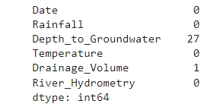
STEP
02
STEP
Data Preprocessing
In the preprossing step we dropped the 'Temperature_Petrignano' column to focus on only one target, therefore, we have 4199 rows and 6 columns in our data, which are: 'Date', 'Rainfall', 'Depth_to_Groundwater', 'Temperature', 'Drainage_Volume', 'River_Hydrometry'.
Missing Values
We saw that we had some missing values, as follows:
'Depth_to_Groundwater' – had 27 missing values and 'Drainage_Volume' – had 1.

Slide 5
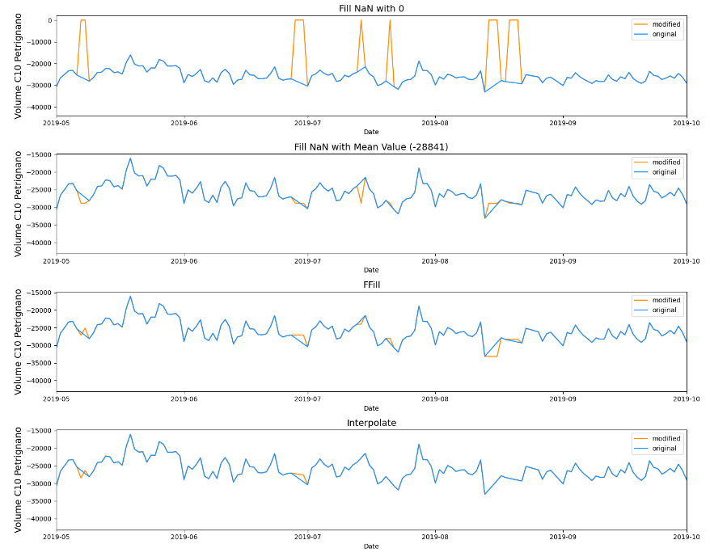
Handling missing values
Now, we have to think about what to do with these missing values.
The orange colour shows the filled values. As we can see, the interpolate might be the best option.
STEP
03
STEP

Slide 6
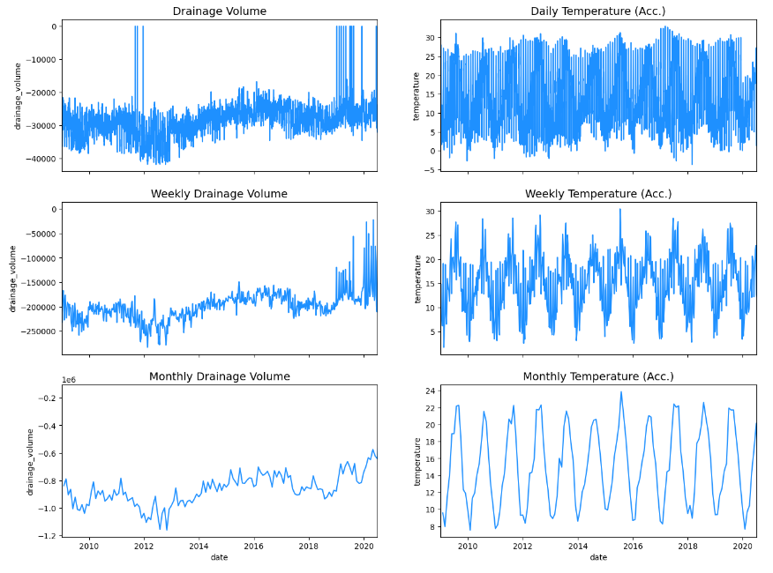
04
Resampling
STEP
STEP
Resampling can provide additional information on the data. In our case, we will do some downsampling with the .resample() function (similar to groupby and aggregate as mean). We will downsample the data to a weekly basis.

Slide 7
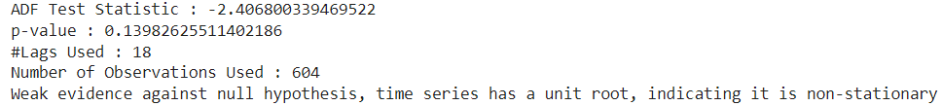
STEP
05
Stationarity
The check for stationarity can be done via different approaches. We are going to check by the statistical way, which by Augmented Dickey-Fuller (ADF).
Augmented Dickey-Fuller (ADF) test is a type of statistical test called a unit root test. Unit roots are a cause for non-stationarity.
Null Hypothesis (H0): Time series has a unit root. (Time series is not stationary).
Alternate Hypothesis (H1): Time series has no unit root (Time series is stationary).
The defaults significance level is 5% or 0.05.
1. p-value > significance level (default: 0.05): Fail to reject the null hypothesis (H0), the data has a unit root and is non-stationary.
2. p-value <= significance level (default: 0.05): Reject the null hypothesis (H0), the data does not have a unit root and is stationary.
Our test’s result shows as down:
STEP
STEP

Slide 8
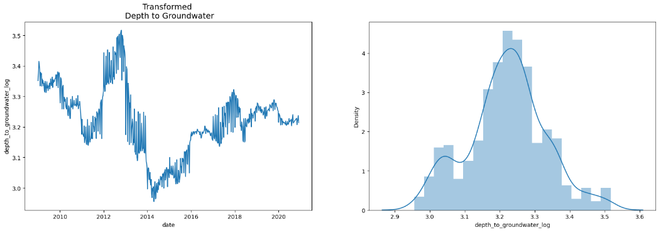
STEP
06
Transforming the data
If the data is not stationary but we want to use a model such as ARIMA (that requires this characteristic), the data has to be transformed.
The two most common methods to transform series into stationarity ones are:
Transformation: e.g. log or square root to stabilize non-constant variance
Differencing: subtracts the current value from the previous
After the Log Transform of absolute values we have the following chart:
STEP
STEP

Slide 9
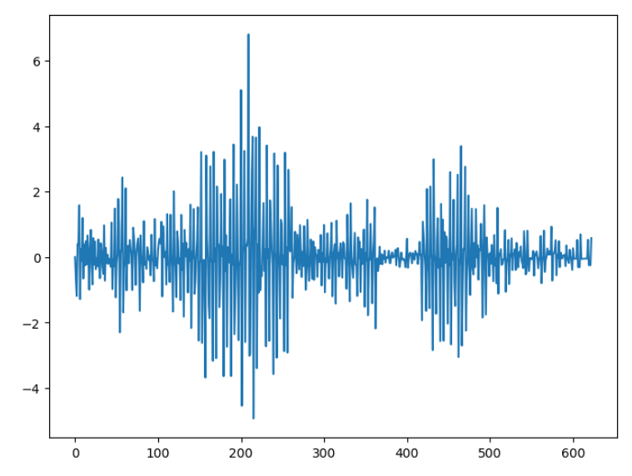
07
First order differencing
Differencing can be done in different orders:
First order differencing: linear trends with
Second-order differencing: quadratic trends with and so on...
After differencing the first order we have the chart:
STEP
STEP
STEP

Slide 10
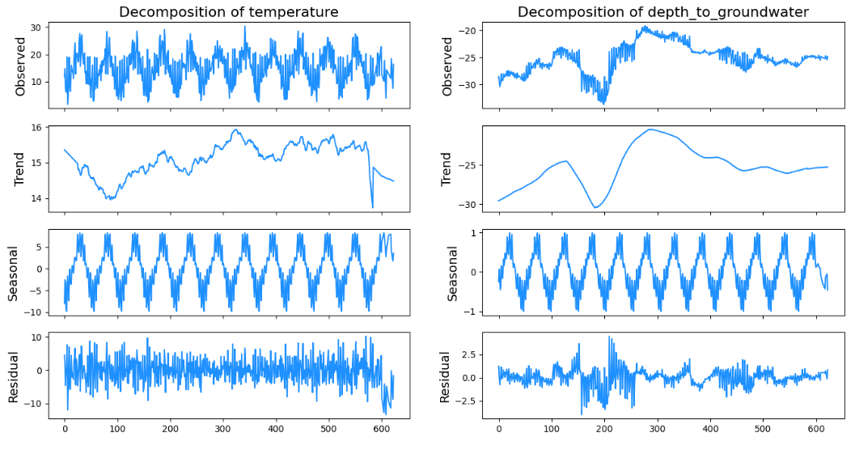
STEP
08
STEP
STEP
Part 2. Feature Engineering
Decomposition
Decomposition provides a useful abstract model for thinking about time series generally and for better understanding problems during time series analysis and forecasting.
These components are defined as follows:
Level: The average value in the series.
Trend: The increasing or decreasing value in the series.
Seasonality: The repeating short-term cycle in the series.
Noise: The random variation in the series.
All series have a level and noise. The trend and seasonality components are optional

Slide 11
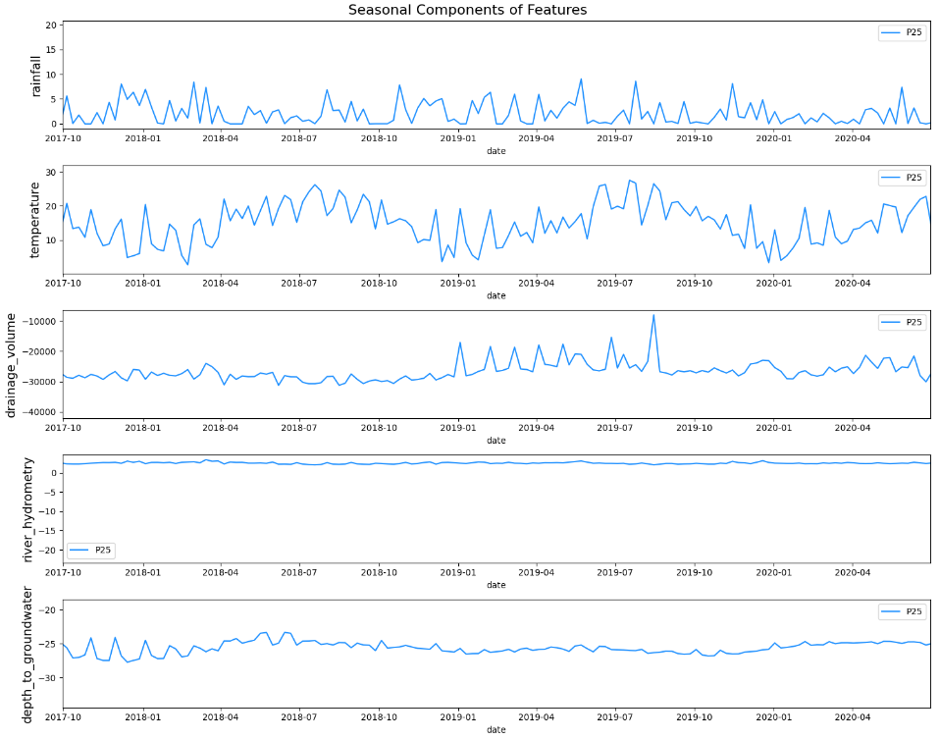
STEP
09
STEP
STEP
STEP
Seasonal Components of Features
As we can see:
Depth_to_groundwater: reaches its maximum around May/June and its minimum around November
Temperature: reaches its maxmium around August and its minimum around January
Drainage_volume: reaches its minimum around July.

Slide 12
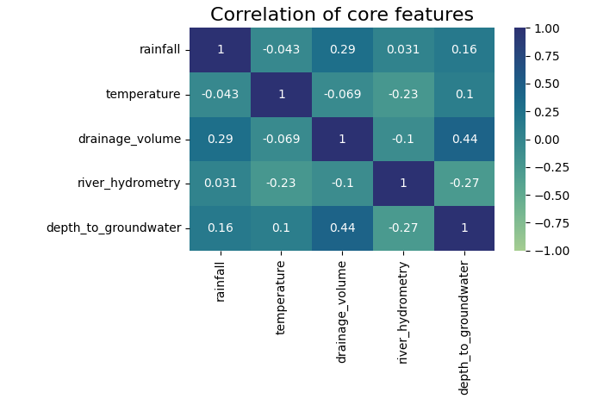
STEP
10
STEP
STEP
STEP
Autocorrelation Analysis
STEP

Slide 13
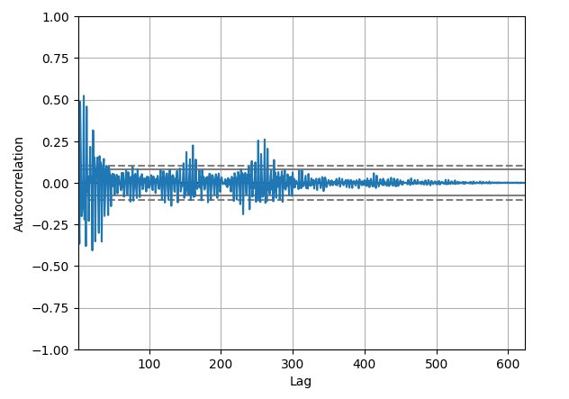
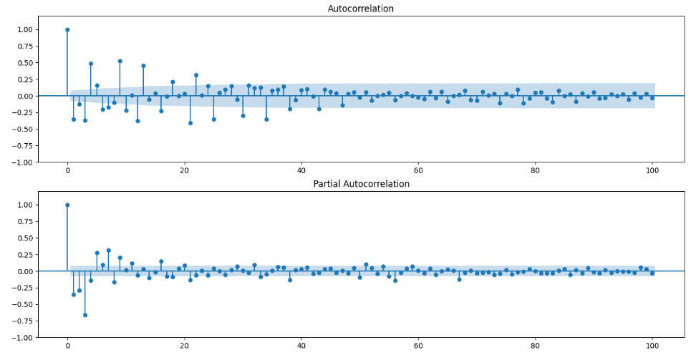
STEP
11
Auto and partial correlation
STEP
STEP
STEP
STEP
STEP
Autocorrelation plot of ‘Depth_to_Groundwater’ of first difference looks like this:
Auto and partial correlation of the 'depth_to_groundwater_diff_1' column with 100 lags.

Slide 14
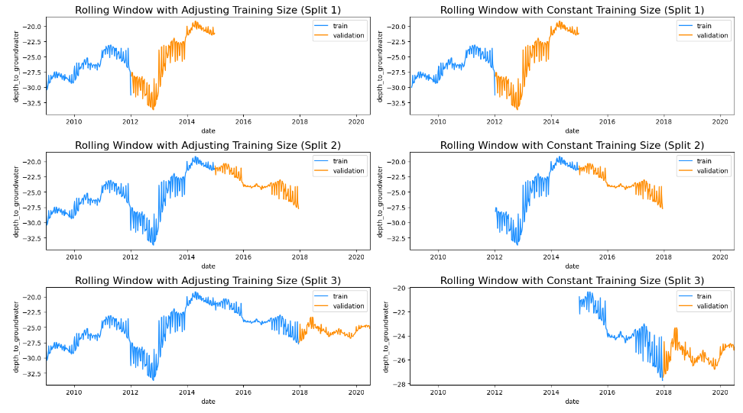
STEP
12
STEP
STEP
STEP
STEP
STEP
Train & Test Split and Cross Validation
After splitting and cross validation we can see the following chart:
TimeSeriesSplit is a specific cross-validation technique designed for time series data. It differs from traditional cross-validation methods because it takes into account the temporal order of data points, which is crucial in time series analysis.
Model Training and Evaluation: You train and evaluate your model on each fold. Since the data in each fold is sequential, this helps simulate a more realistic scenario where you train on past data and test on future data.
The blue colour displays the training part and the orange one is the validation part.

Slide 15
STEP
13
STEP
STEP
STEP
STEP
STEP
Modelling
Time series can be either univariate or multivariate:
Univariate time series only has a single time-dependent variable.
Multivariate time series have a multiple time-dependent variable.
We will evaluate the Mean Absolute Error (MAE) and the Root Mean Square Error (RMSE) of the models. For metrics are better the smaller they are.

Slide 16
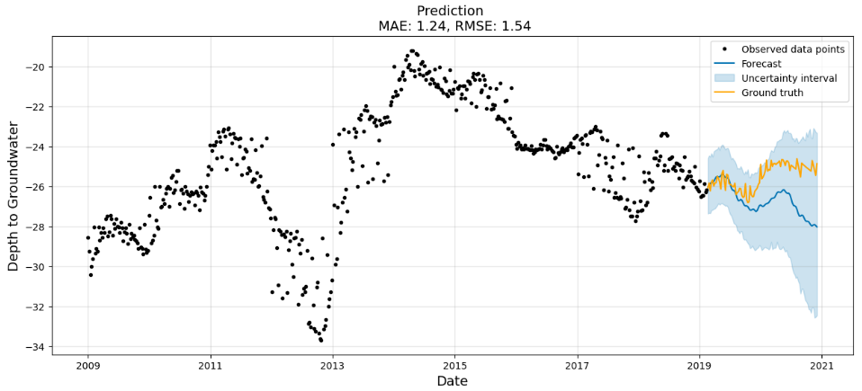
STEP
14
Prophet
The first model we are going to try is Facebook Prophet.
Prophet, or “Facebook Prophet,” is an open-source library for univariate (one variable) time series forecasting developed by Facebook.
Prophet implements what they refer to as an additive time series forecasting model, and the implementation supports trends, seasonality, and holidays.
The Prophet has: RMSE: 1.542001236114489, MAE: 1.2373973862599126
STEP
STEP
STEP
STEP
STEP

Slide 17
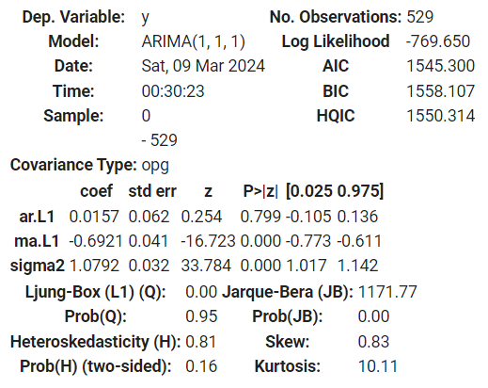
STEP
15
STEP
STEP
STEP
STEP
STEP
The summary report of ARIMA test:
ARIMA model
The Auto-Regressive Integrated Moving Average (ARIMA) model describes the autocorrelations in the data. The model assumes that the time-series is stationary. It consists of three main parts:
p: Lag order (reference PACF in Autocorrelation Analysis)
2. d: Degree of differencing. (reference Differencing in Stationarity)
3. q: Order of moving average (check out ACF in Autocorrelation Analysis)

Slide 18
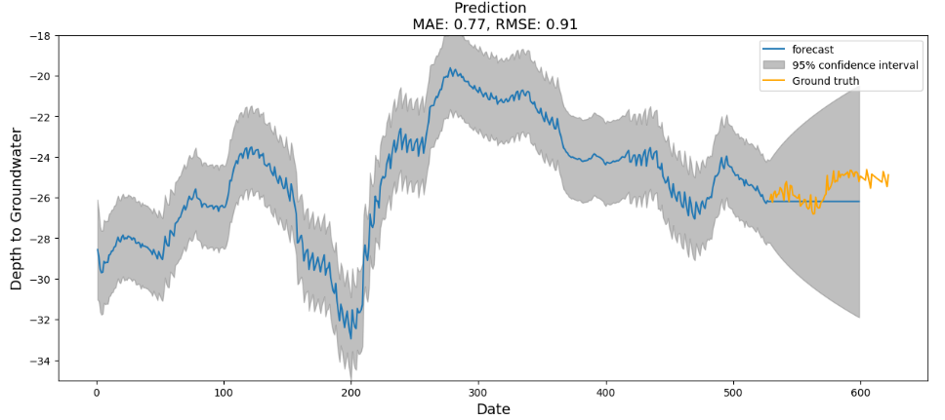
STEP
16
STEP
STEP
STEP
STEP
ARIMA plot prediction with RMSE & MAE
STEP
The ARIMA has: RMSE: 0.9138188382174358, MAE: 0.7739767755202263

Slide 19
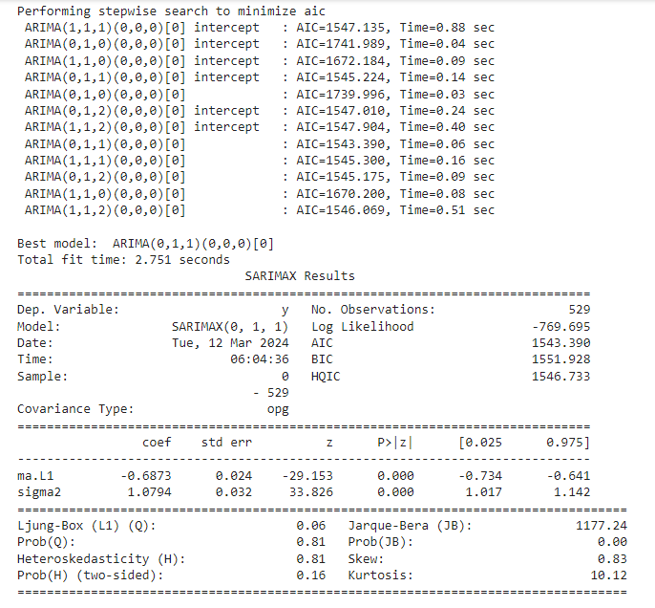
STEP
17
The summary of Auto-ARIMA
STEP
STEP
STEP
STEP
STEP
Auto-ARIMA model
AutoARIMA is a statistical modelling technique for time series forecasting that automates the process of selecting the order of an ARIMA (AutoRegressive Integrated Moving Average) model.
The ARIMA model is a powerful and widely used method for forecasting time series data, but selecting the appropriate model order (p, d, q) can be a challenging and time-consuming task.
Here, our model performs steps to identify the p,d, q variables
Here, our model found the best fitting for the p, d, q variables

Slide 20
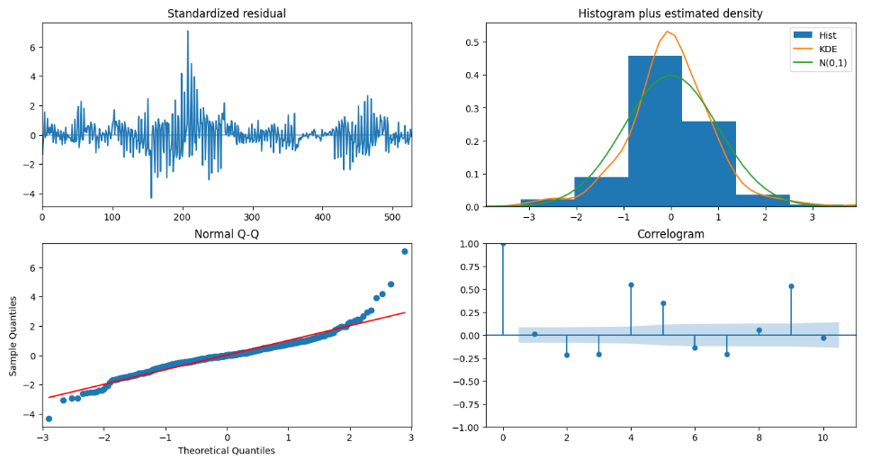
STEP
18
Auto-ARIMA chart with RMSE & MAE
STEP
STEP
STEP
STEP
STEP
The Auto – Arima has: RMSE: 0.9146542146751206, MAE: 0.7747341325727144
For evaluating the mode we plotted diagnostic chart.

Slide 21
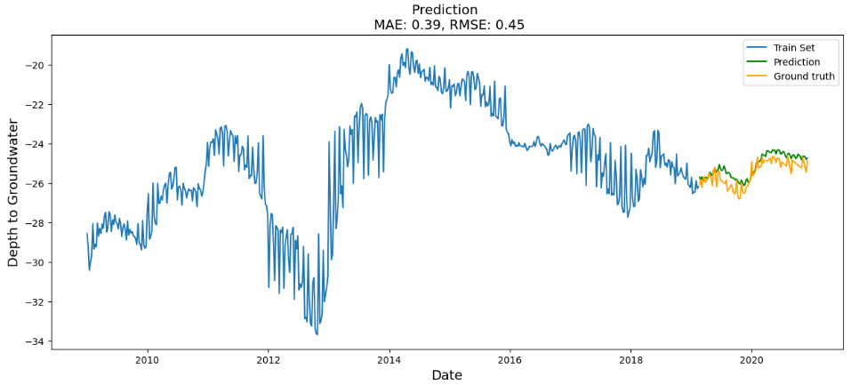
STEP
19
STEP
STEP
STEP
STEP
STEP
The LSTM has: RMSE: 0.4548196970026224, MAE: 0.3908846915665366
LSTM model
We are going to use a multi-layered LSTM recurrent neural network to predict the last value of a sequence of values.
The following data pre-processing and feature engineering need to be done before construct the LSTM model:
Create the dataset, ensure all data is float.
Normalize the features.
Split into training and test sets.
Convert an array of values into a dataset matrix.
Reshape into X=t and Y=t+1
Reshape input to be 3D (num_samples, num_timesteps, num_features)

Slide 22
STEP
20
STEP
STEP
STEP
STEP
STEP
Conclusion
*In conclusion, this comprehensive guide to time series analysis has covered key aspects from data visualization and preprocessing to advanced modelling techniques.
We've explored methods for handling missing data
Achieving stationarity
Conducting critical tests like the ADF test.
Transformations, feature engineering, and encoding cyclic features have been discussed to enhance model performance.
Time series decomposition
Lag analysis
Partial Autocorrelation and Autocorrelation exploration have been instrumental in understanding data patterns.
We've also delved into both univariate and multivariate modelling approaches, including the use of Prophet, ARIMA, Auto – ARIMA, and LSTM models.
At the end we've discovered that the best models is LSTM (with MAE = 0.39 and RMSE = 0.45) for this analysis.

